Slide 1
BRITISH AIRWAYS FORAGE PROGRAM
INSIGHTS FROM CUSTOMER REVIEWS

Slide 2
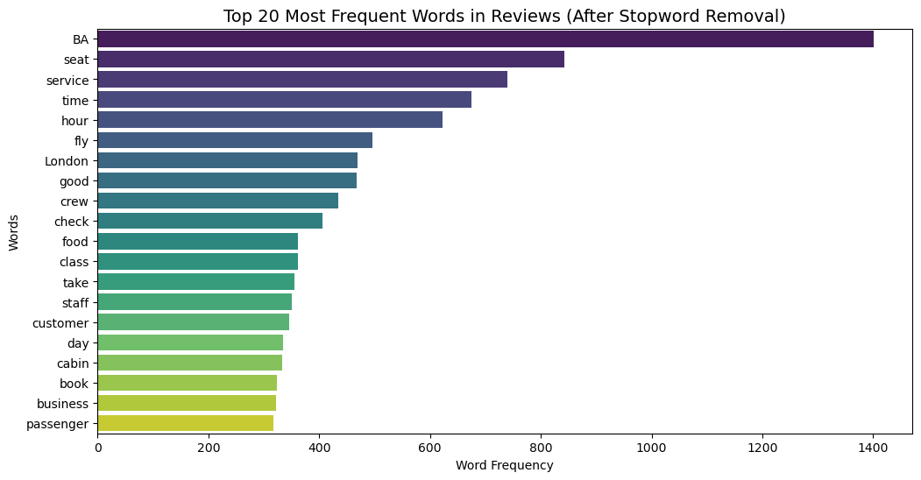
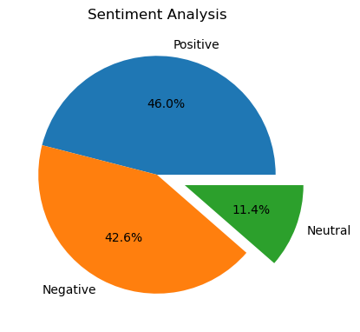
KEY INSIGHTS
Positive Reviews - 460
Negative Reviews - 426
Neutral Reviews – 114
Distribution of the reviews
Words that appeared the most in the user reviews

